Slide 1
Quelques sites touristiques
dans la
BELGIQUE!

Slide 2
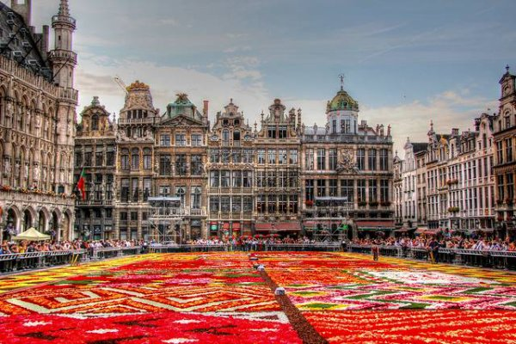
Au centre de Bruxelles:
La Grande Place

Slide 3
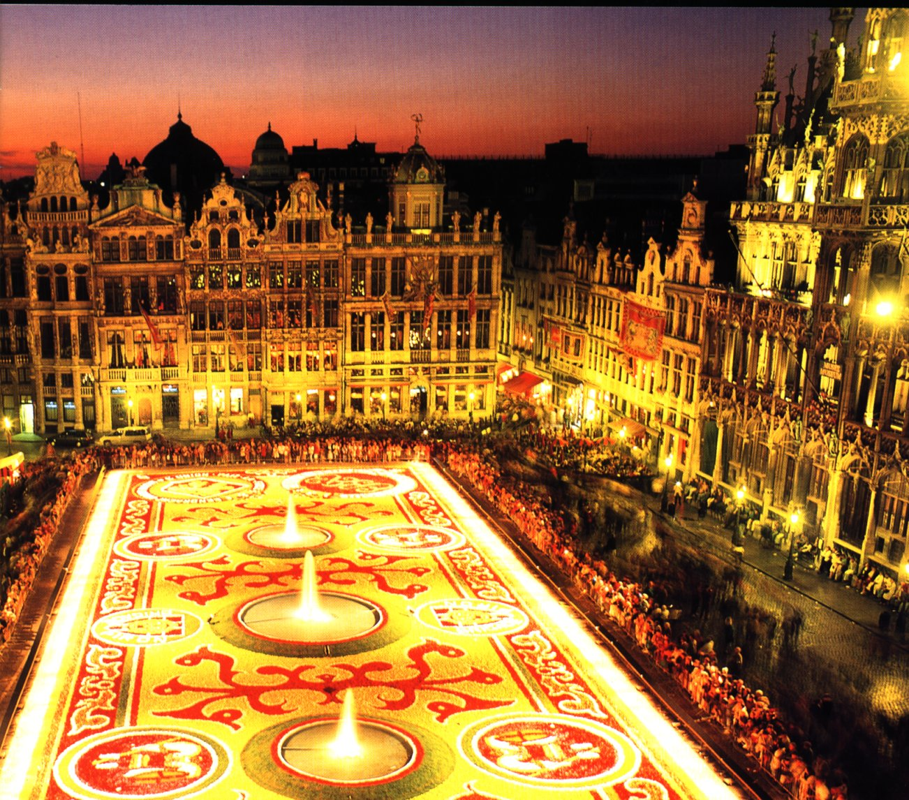
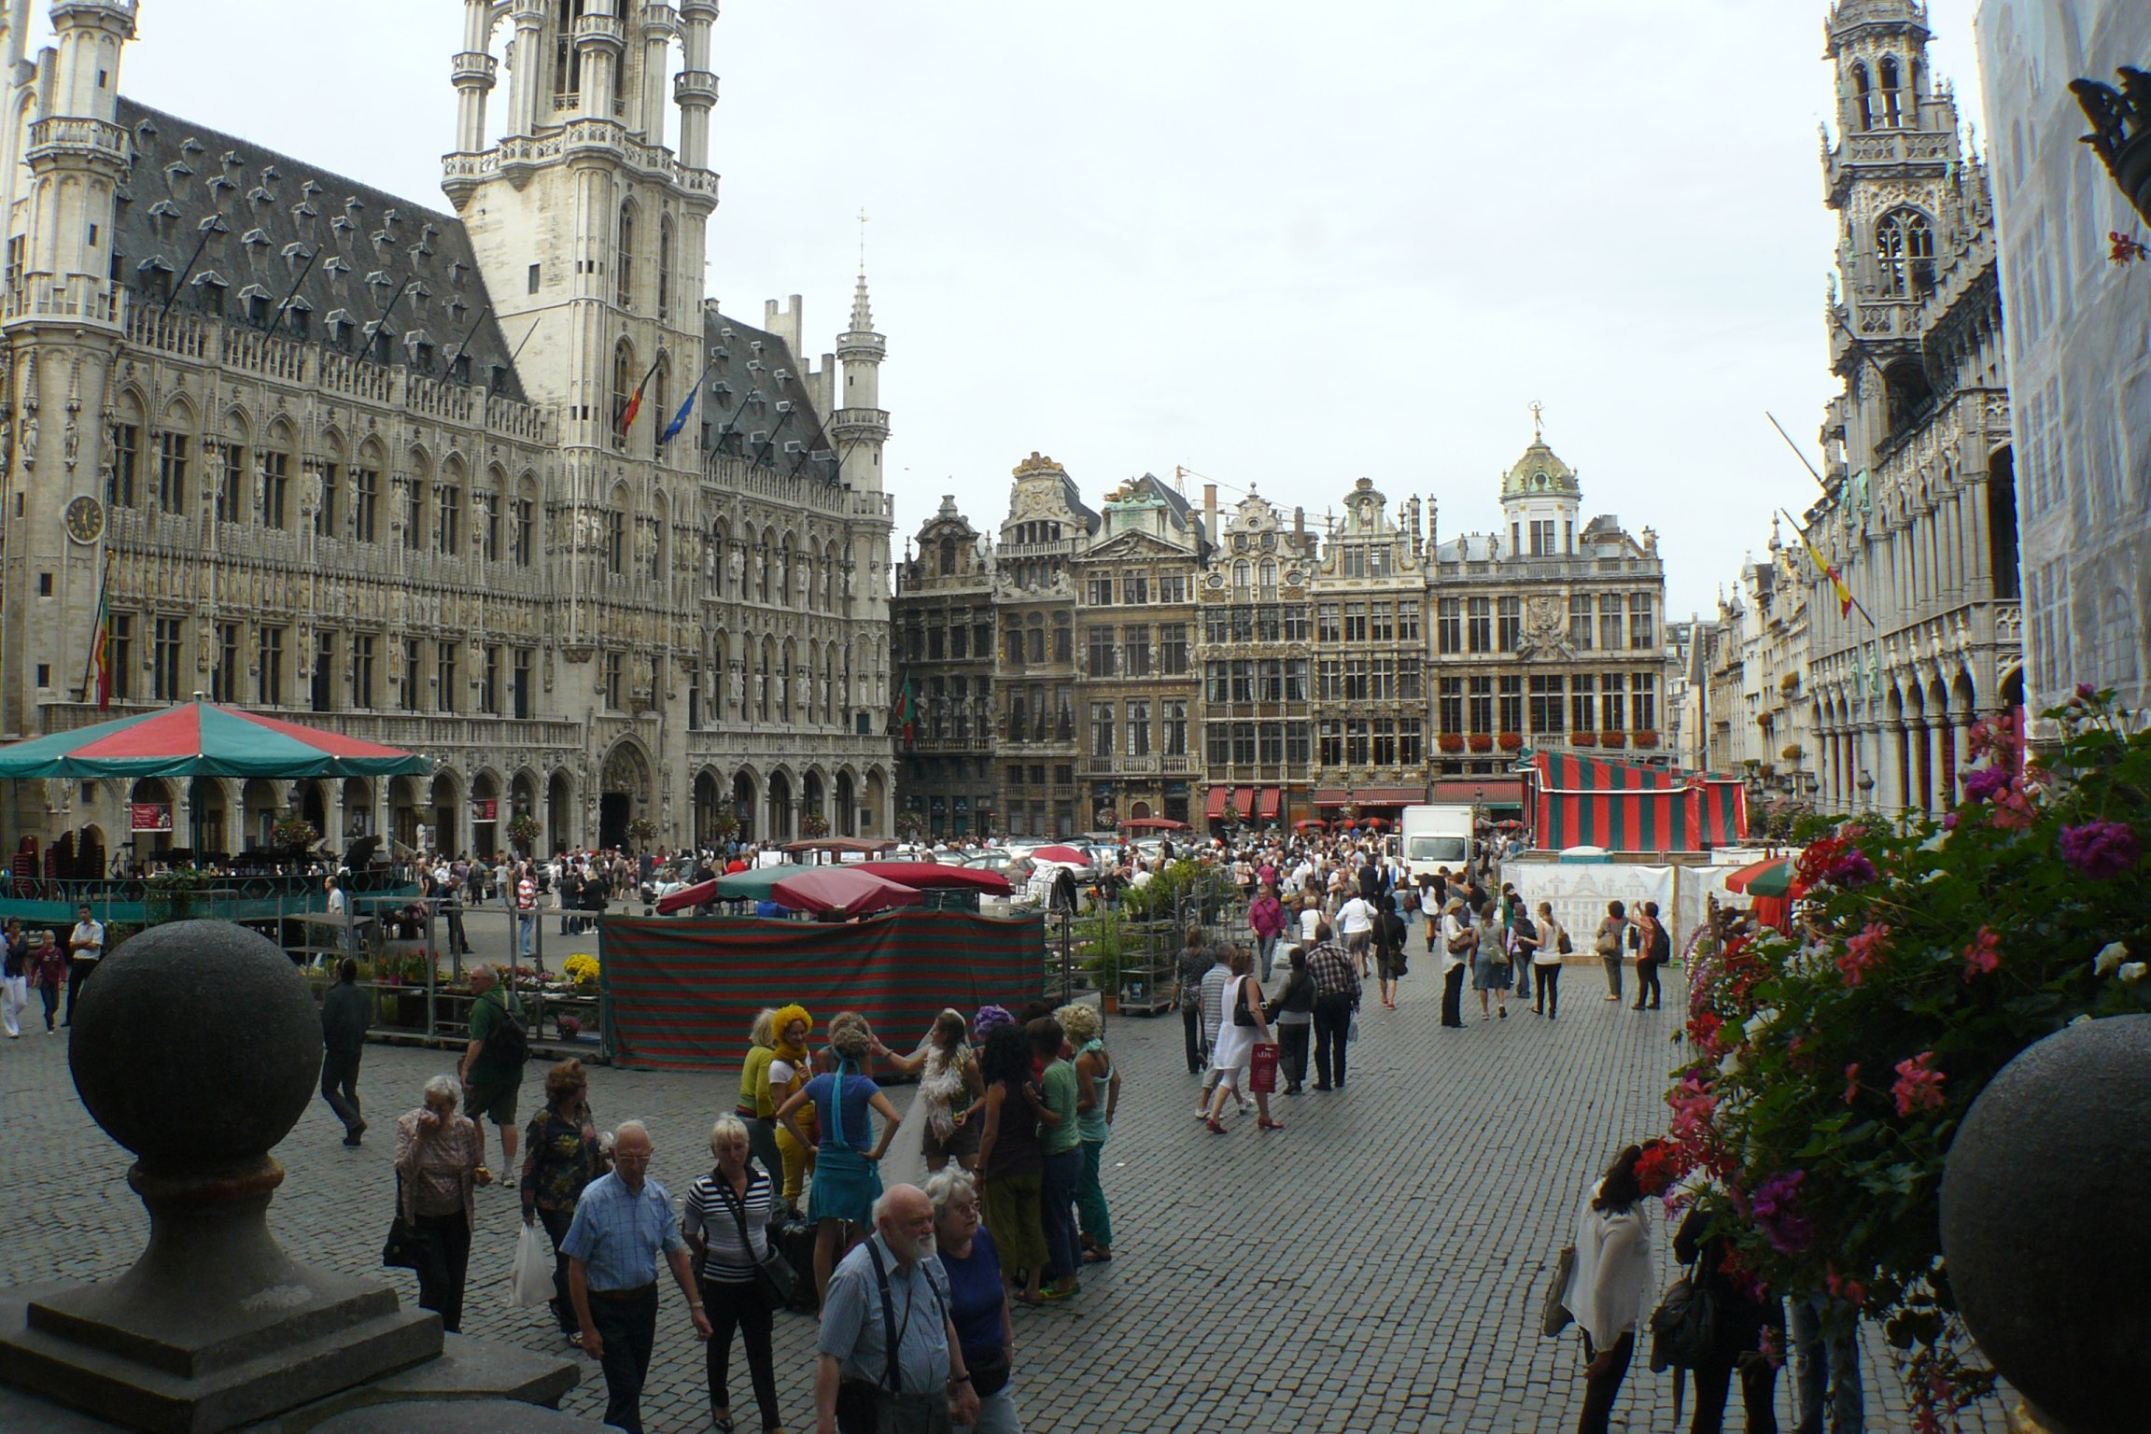

Slide 4
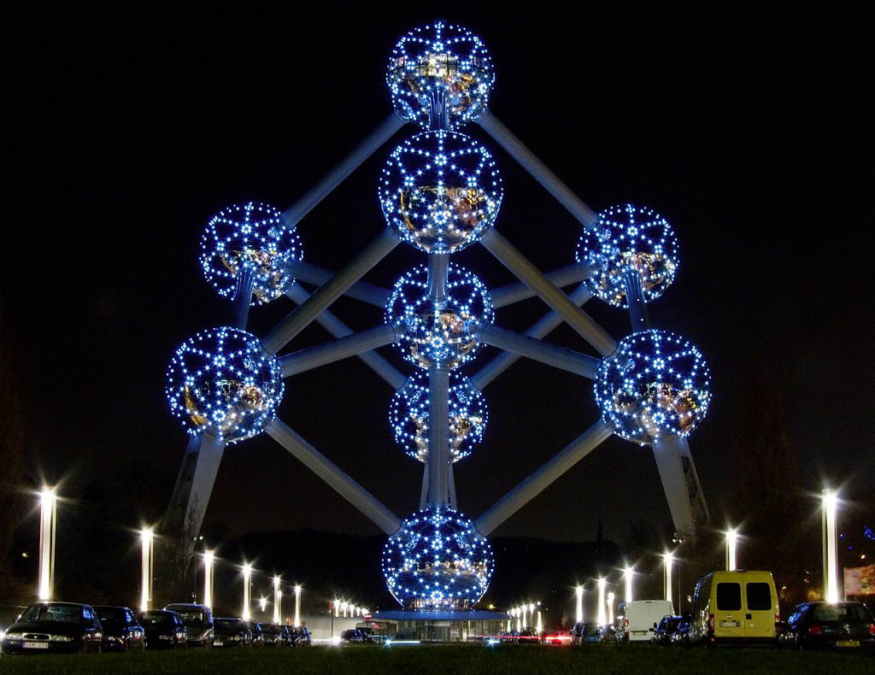
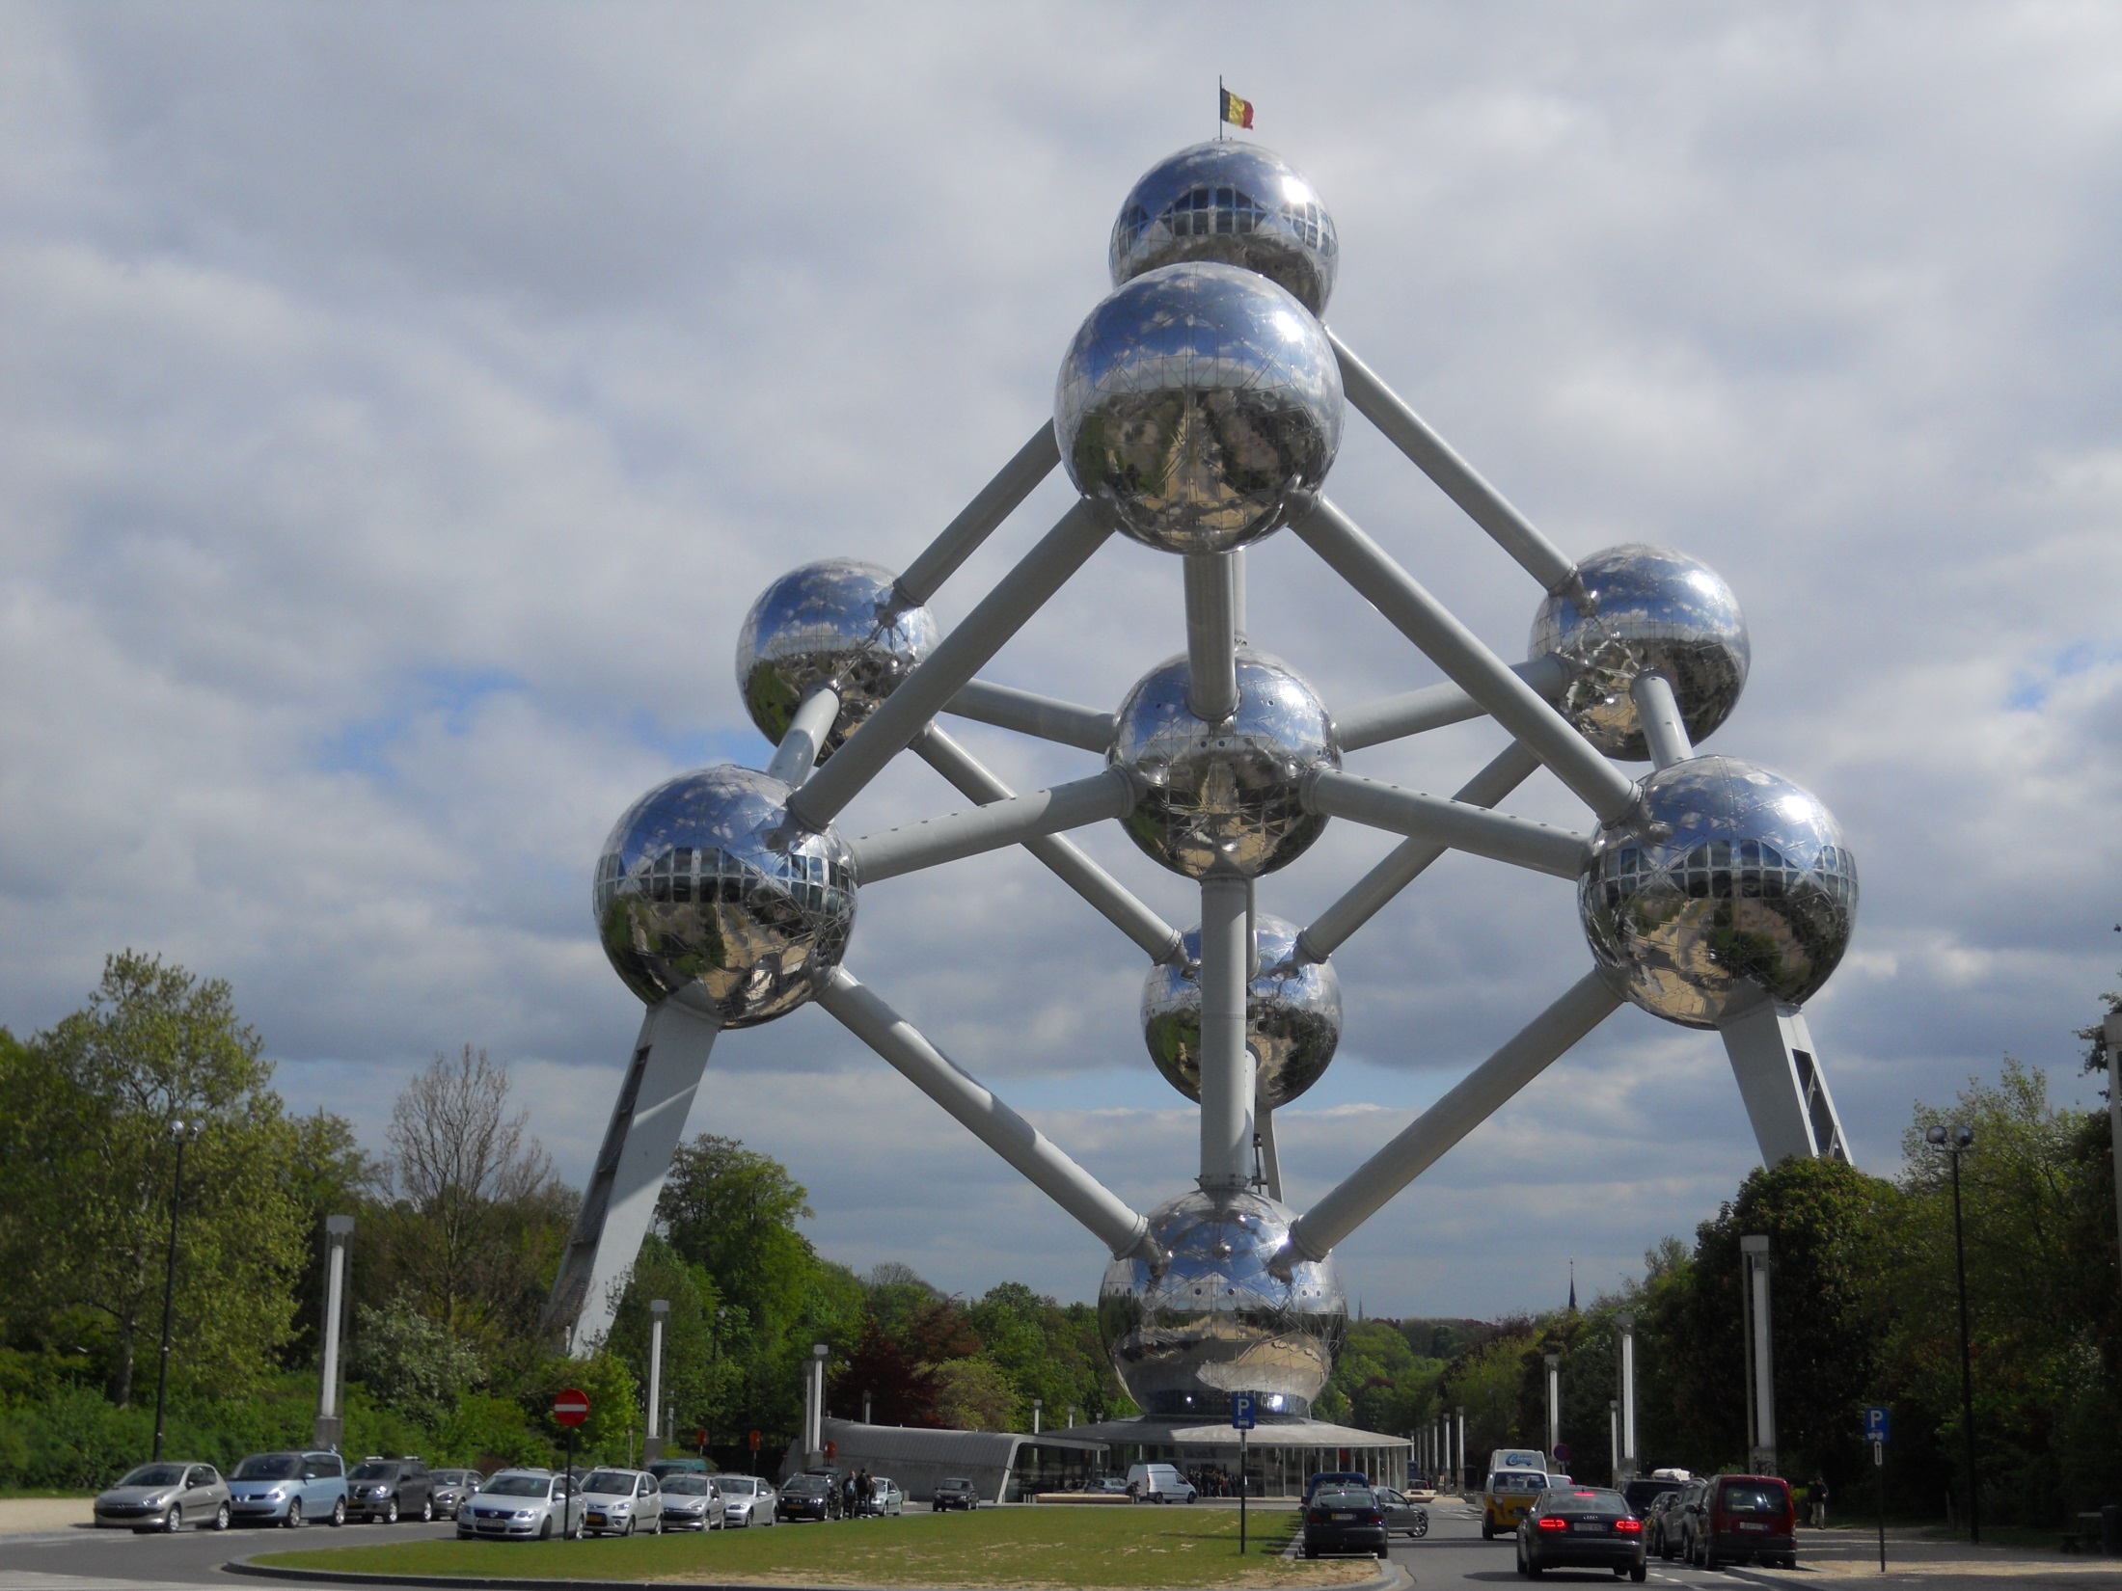
L’Atomium
(à Bruxelles)
http://www.atomium.be/

Slide 5
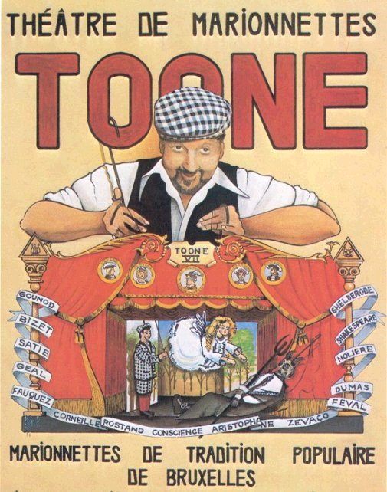
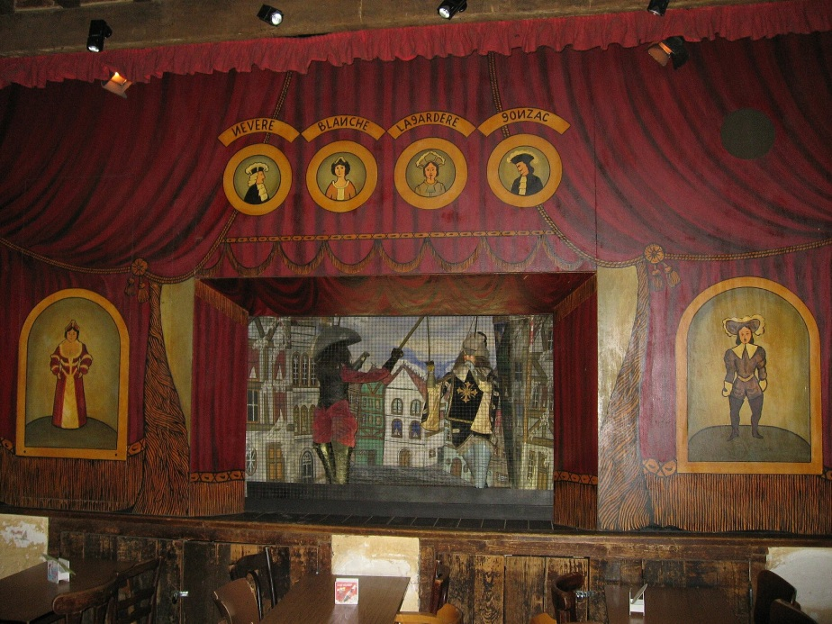
Le Théâtre de Marionnettes de Toone
à Bruxelles
http://www.youtube.com/watch?v=yqPJ1AhnFVQ

Slide 6
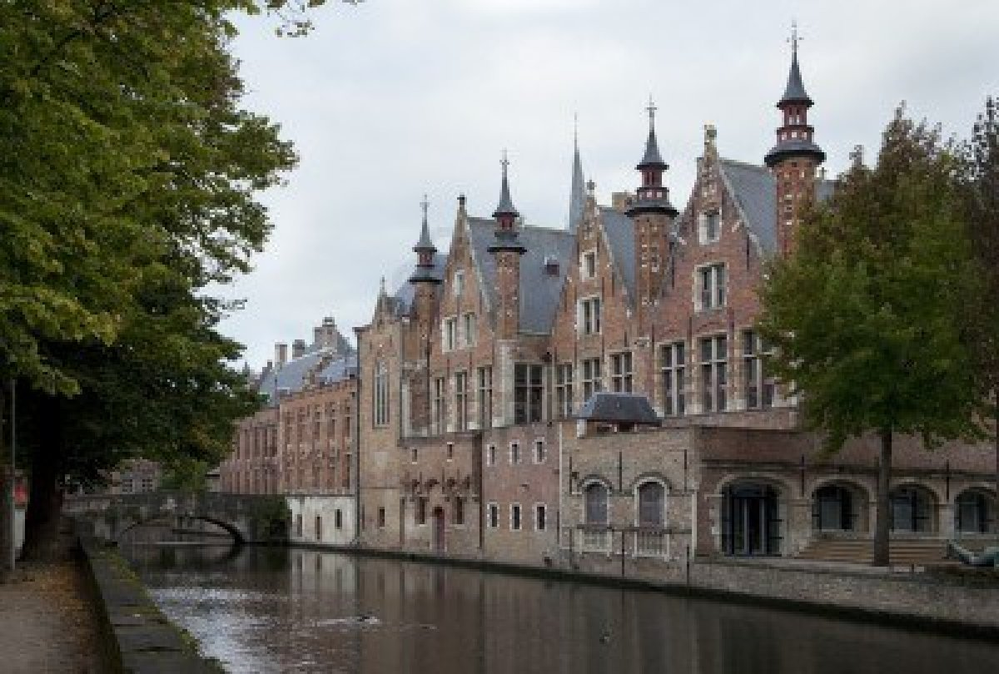
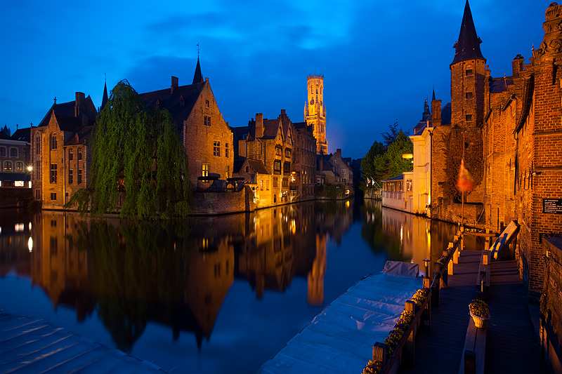
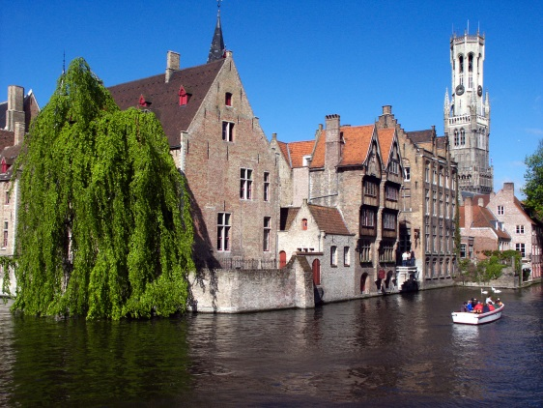
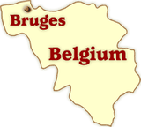
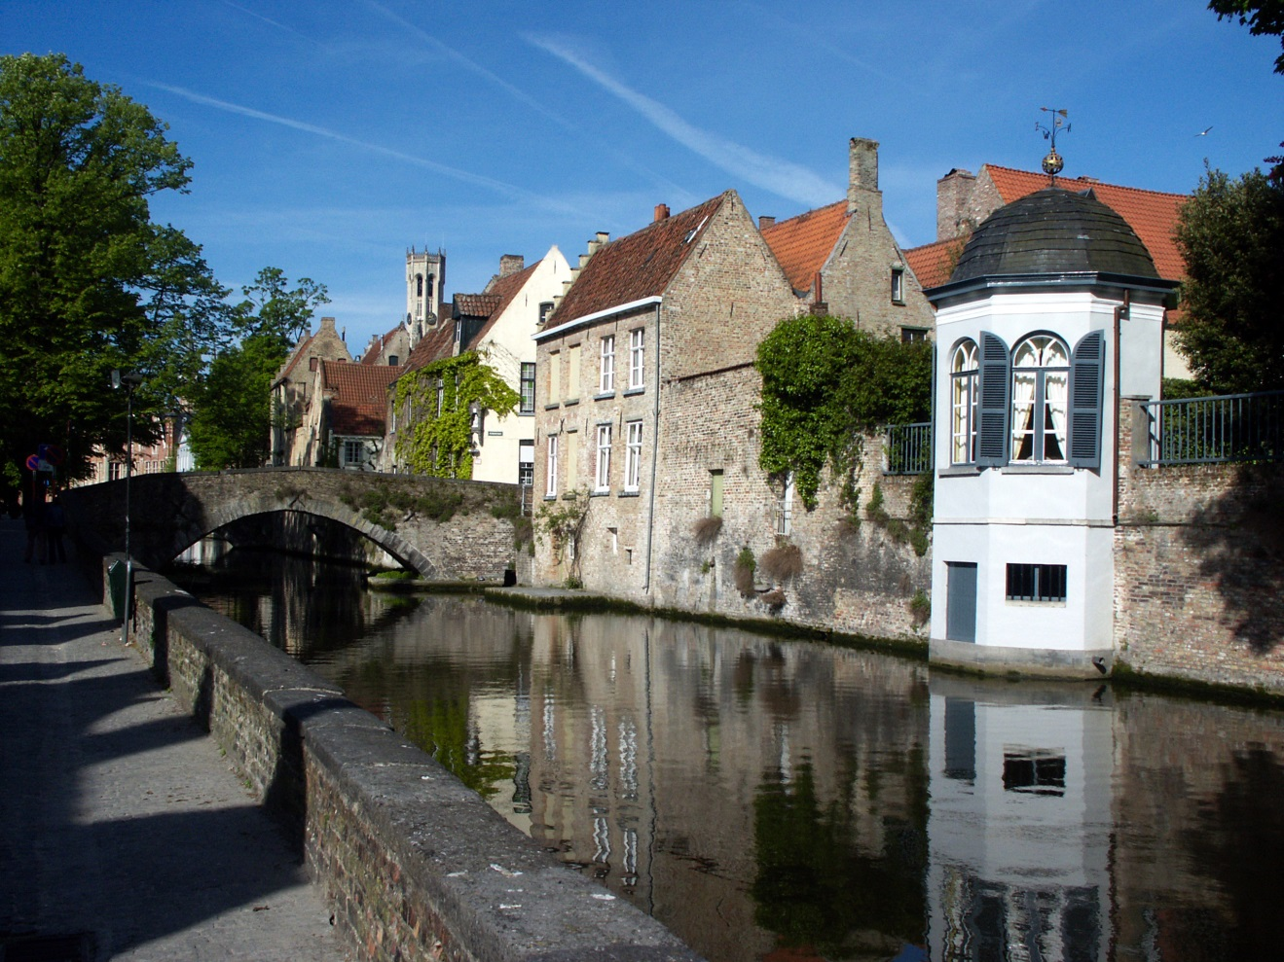
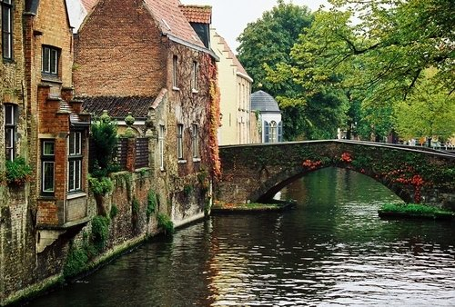
Where is Bruges?:
Bruges (Brugge in Dutch), the capital and largest city of the province of West Flanders in Belgium, is located in the northwest corner of Belgium. Bruges is a mere 44km from Ghent to the southeast and 145 from Brussels. See the location map on the right.
Bruges - An Introduction:
On appelle souvent Bruges « la Venise du Nord » grâce à ses beaux canaux.
The medieval center of Bruges is remarkably well preserved, and is a UNESCO world heritage site. Bruges had it's golden age around 1300, when it became one of the most prosperous cities of Europe. Around 1500, the Zwin channel, which provided Bruges with its access to the sea, started silting up, and Bruges began losing its economic strength to Antwerp. People began to abandon the center, which helped to preserve its medieval features. Today Bruges is once again a thriving community with a population of 120,000 people, and the medieval center is one of the most beautiful in Europe.

Slide 7
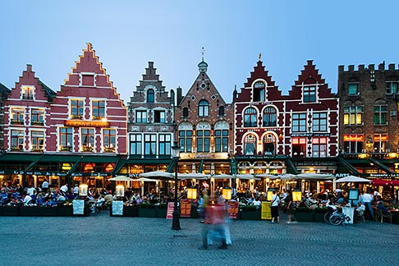

Slide 8
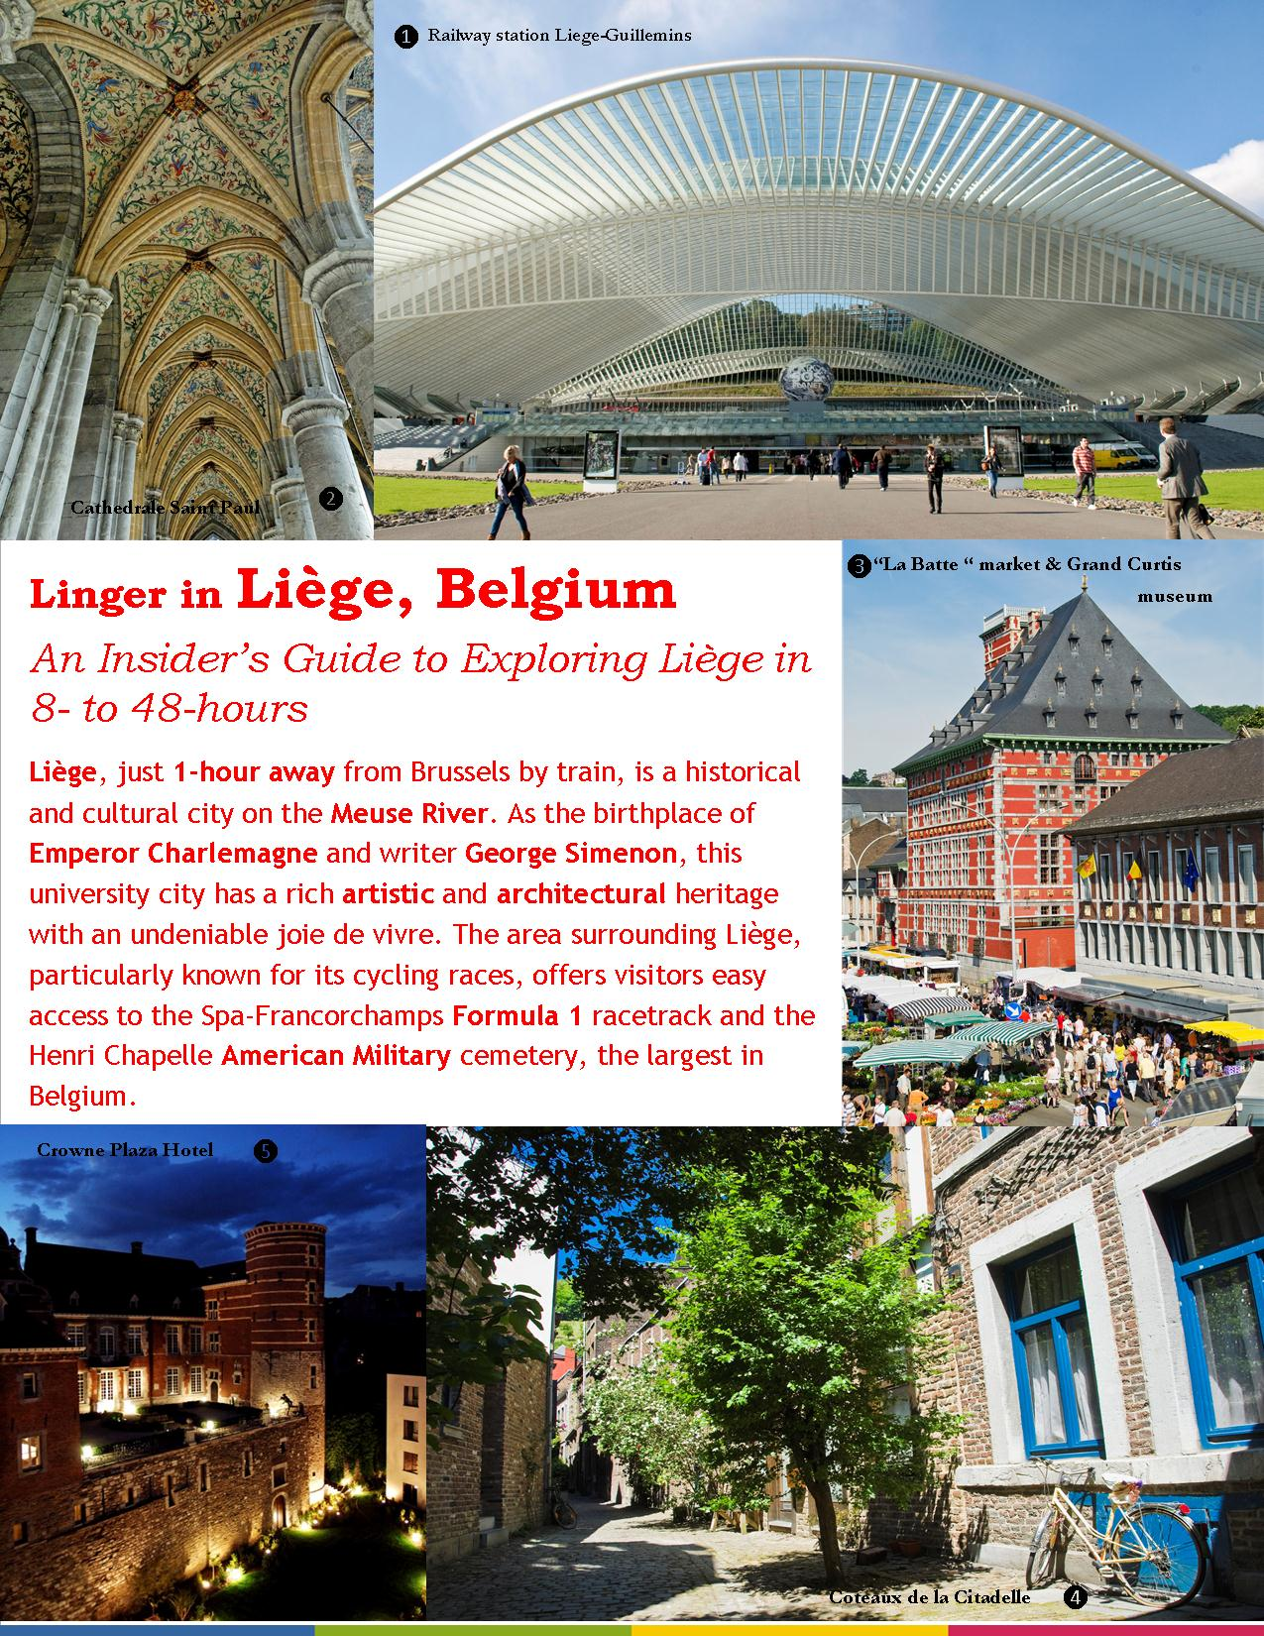
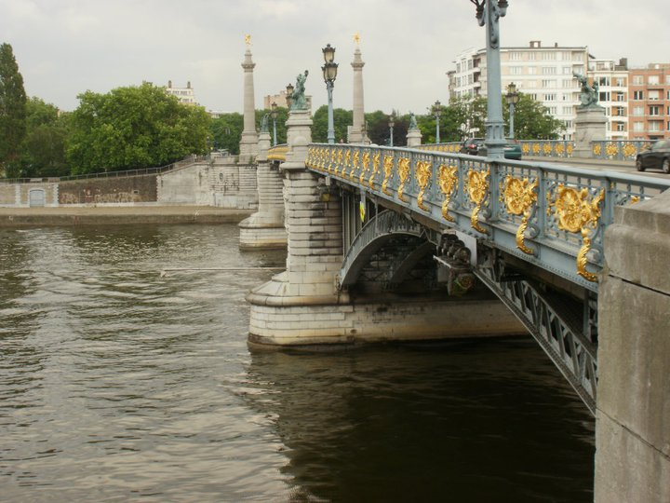
Liège is known as the Palo Alto of Europe, because it is the greatest concentration of digital, technological and Internet-oriented services industries.

Slide 9
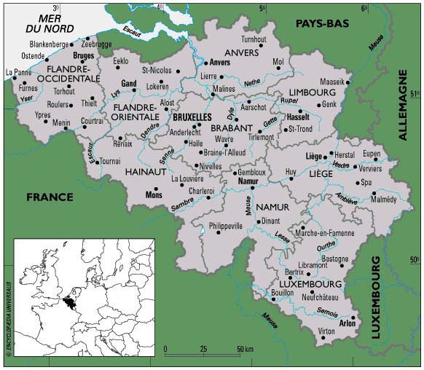
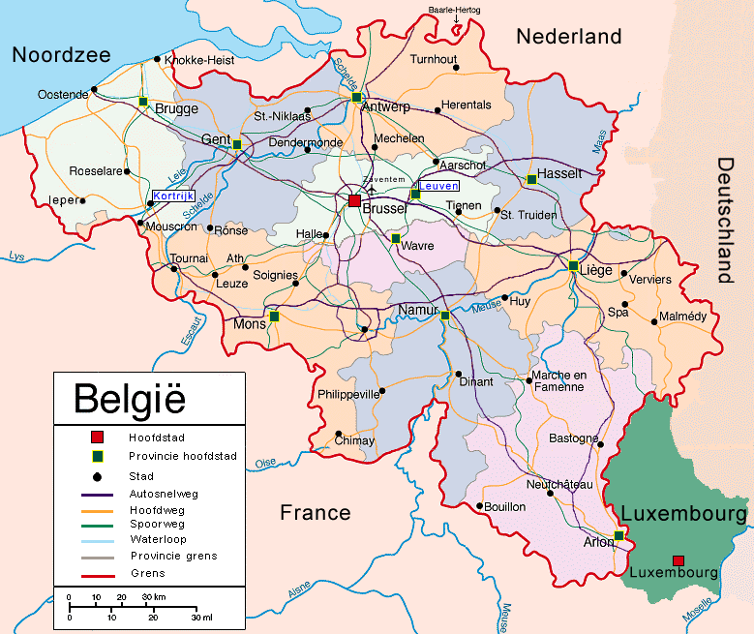

Slide 10
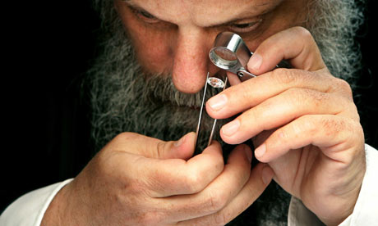
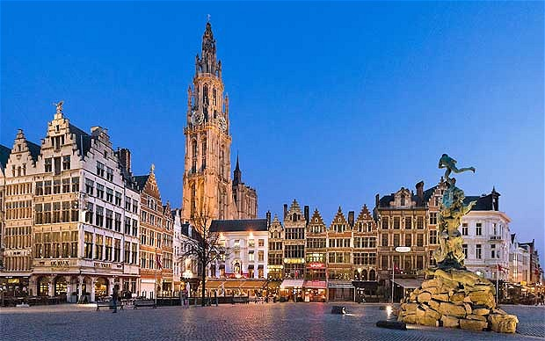
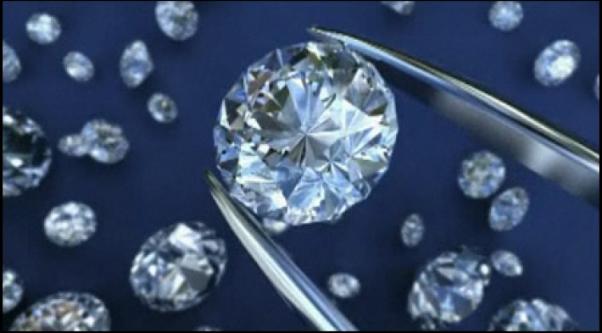
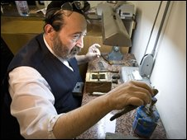
Anvers/Antwerp
http://news.bbc.co.uk/2/hi/europe/7619722.stm
le centre de l’industrie de diamants
Orthodox Jews have controlled the diamond trade since the turn of the 20th century. Despite rising nationalism, they have no problems in the Flemish quarter. Photograph: Francois Lenoir/Reuters

Slide 11
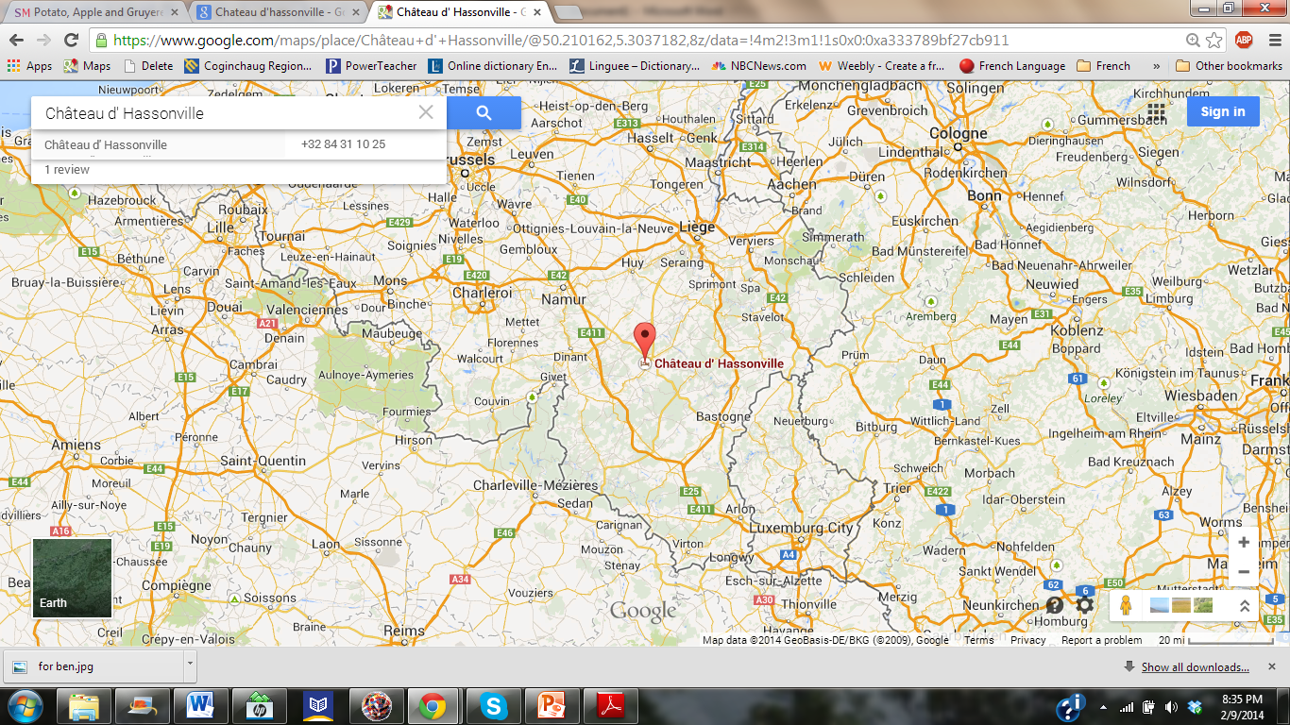
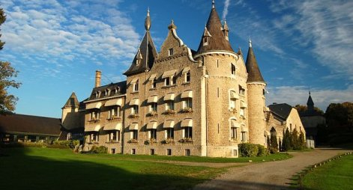
Louis XIV – « le roi soleil » -
a fait bâtir ce château dans la Belgique pour faire la chasse.

Slide 12
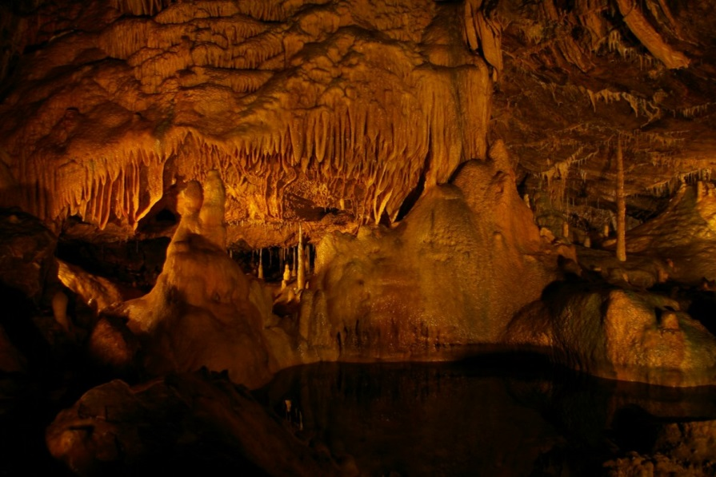
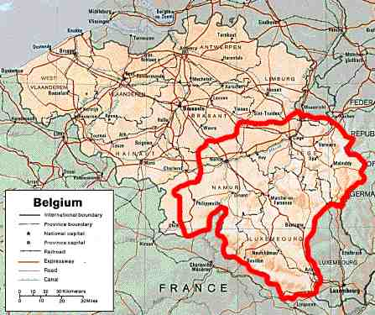
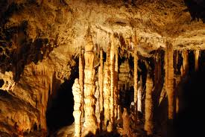
Les Ardennes – une région montagneuse
On y trouve beaucoup de caves!

Slide 13
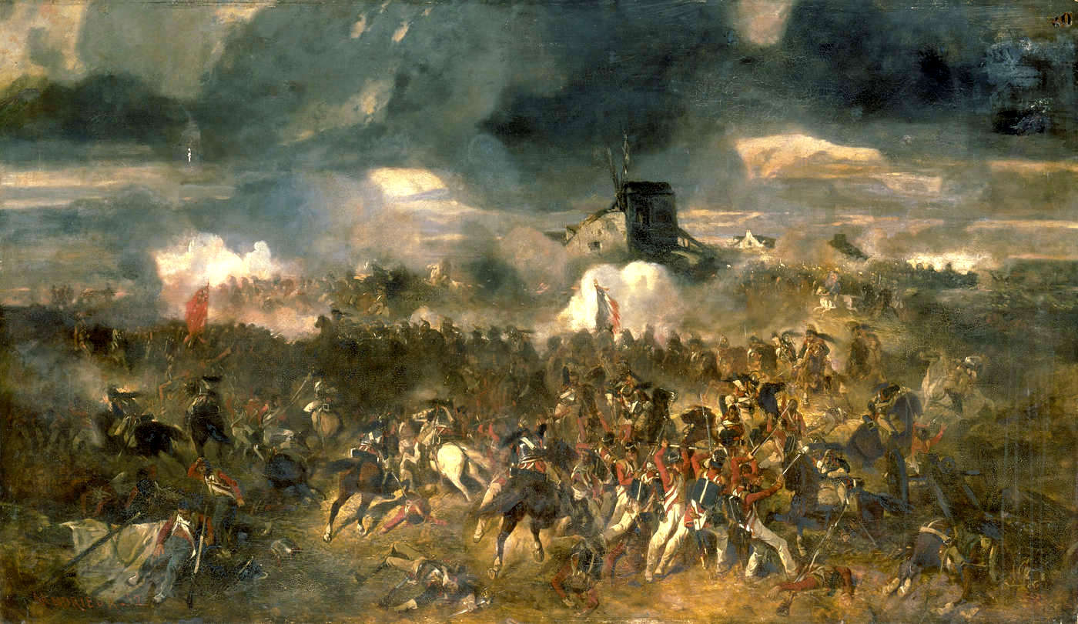
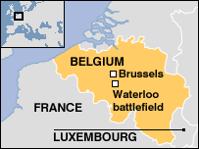
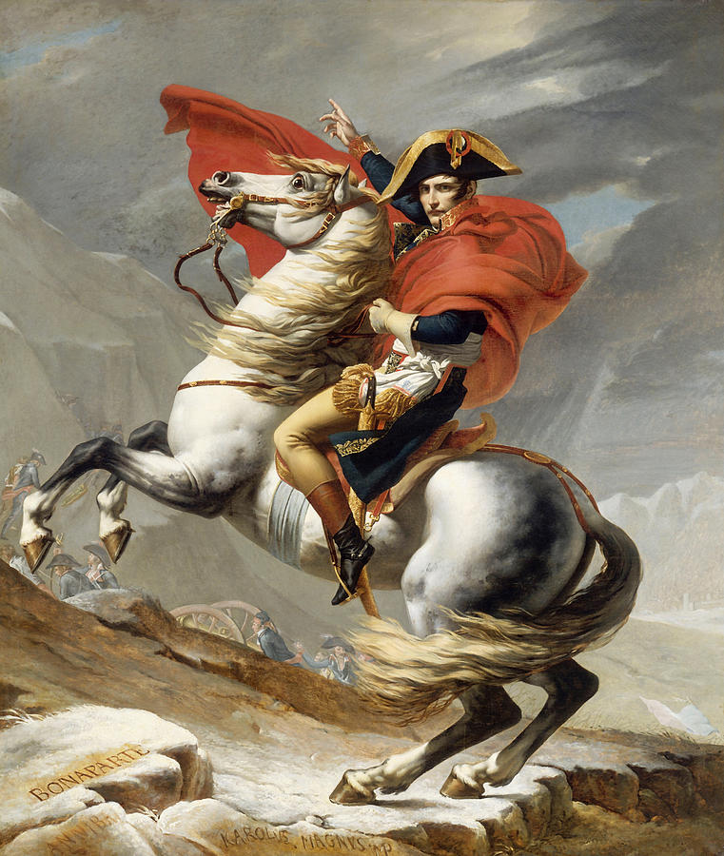
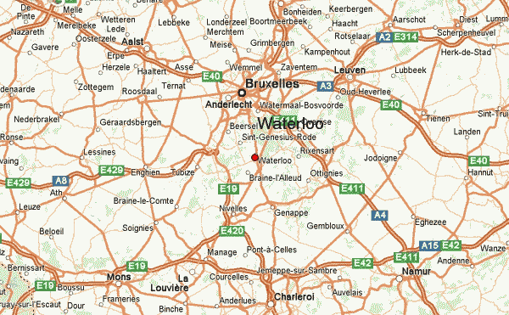
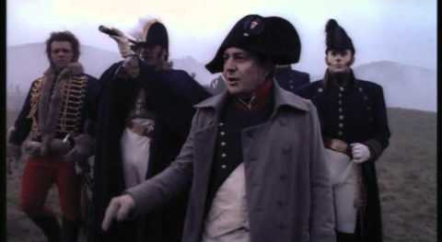
Saviez-vous que la bataille de Waterloo s’est passé en Belgique ?
C’était un désastre pour QUI ?

Slide 14
…et encore une petite notes belge…

Slide 15
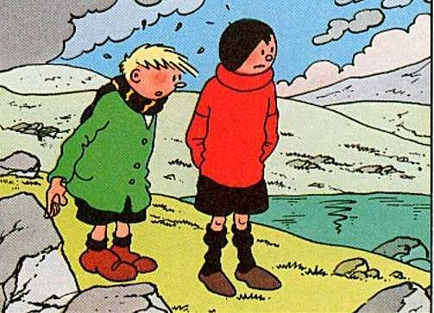
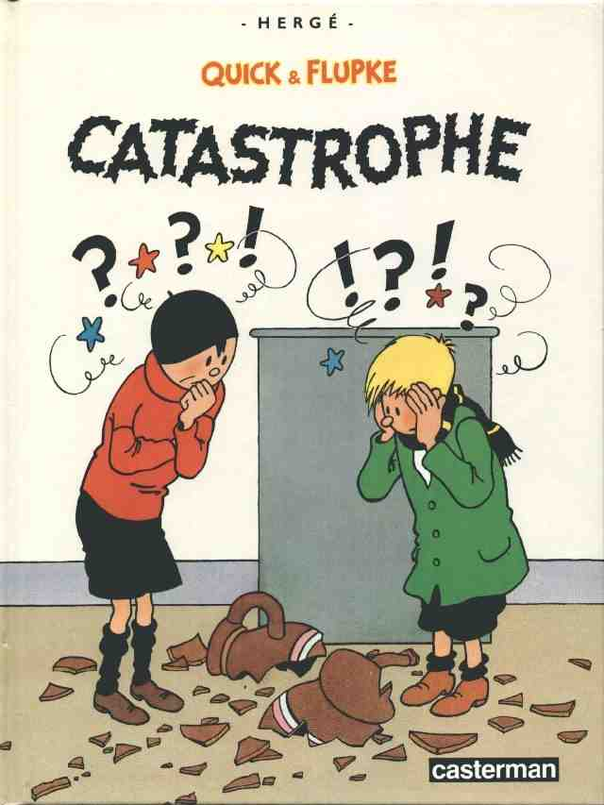
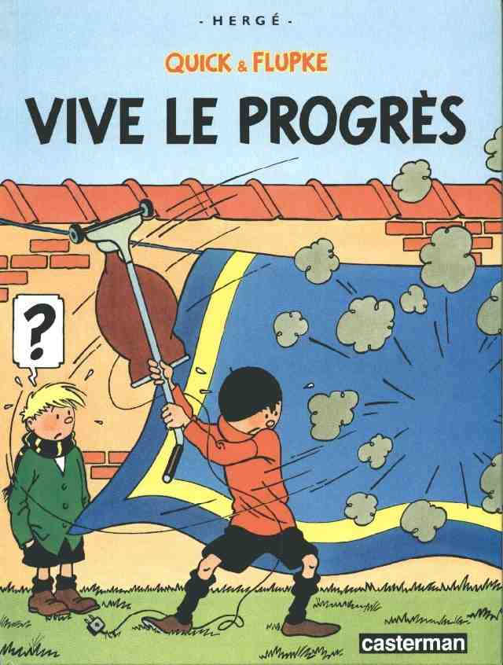
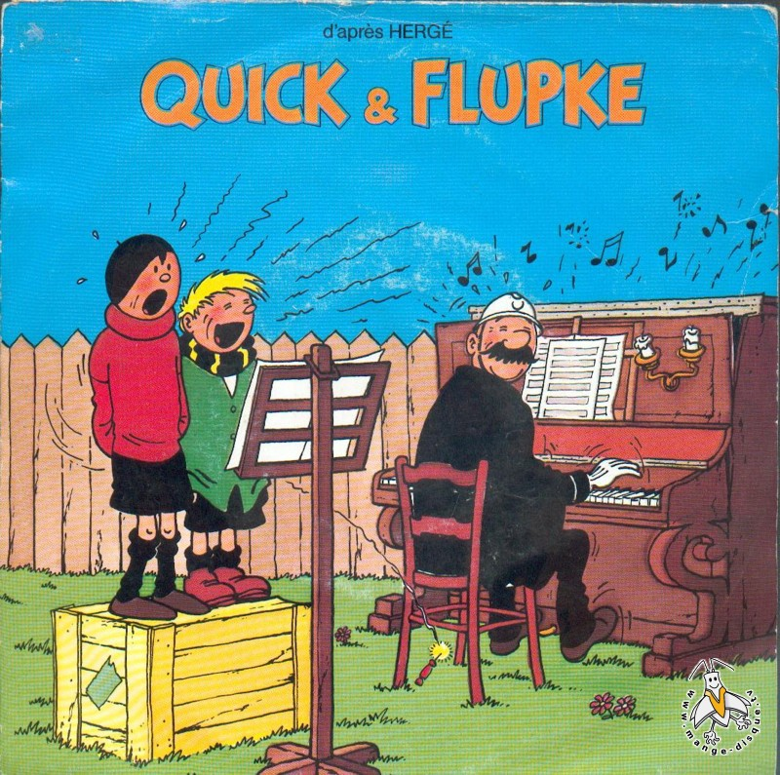
Une
bande-dessinée
belge

